Slide 1
ANALYTICS PRACTICUM

Slide 2
Top walker/Team Captain Analysis
Who- individuals raising more than $1,000
What- make up only 5% of participants but account for 56% of revenue.
Why -A 5% increase in Top Walkers would equate to ~$1.3 million in revenue

Slide 3
Goals
To identify potential Top Walkers/Team Captains in with enough time before the Event date, to perform target communication channels to attempt to motivate, at least, a self-donation.
Questions
What behaviors identify a potential Top Walkers & ideal Team Captains?
What secondary or tertiary elements affect this behavior?
Company-wide participant behavior
Team Captains/Top Walkers

Slide 4
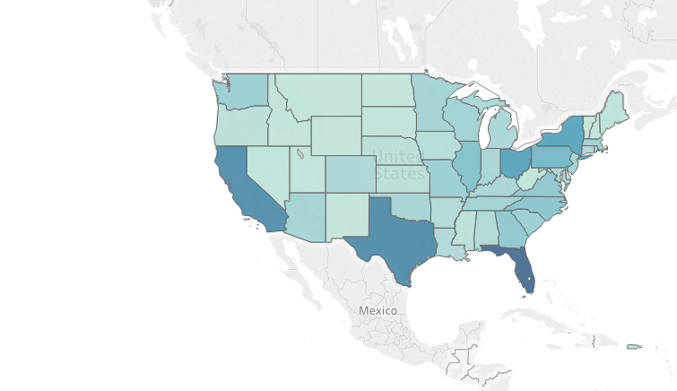
Total gifts by top walkers by state

Slide 5
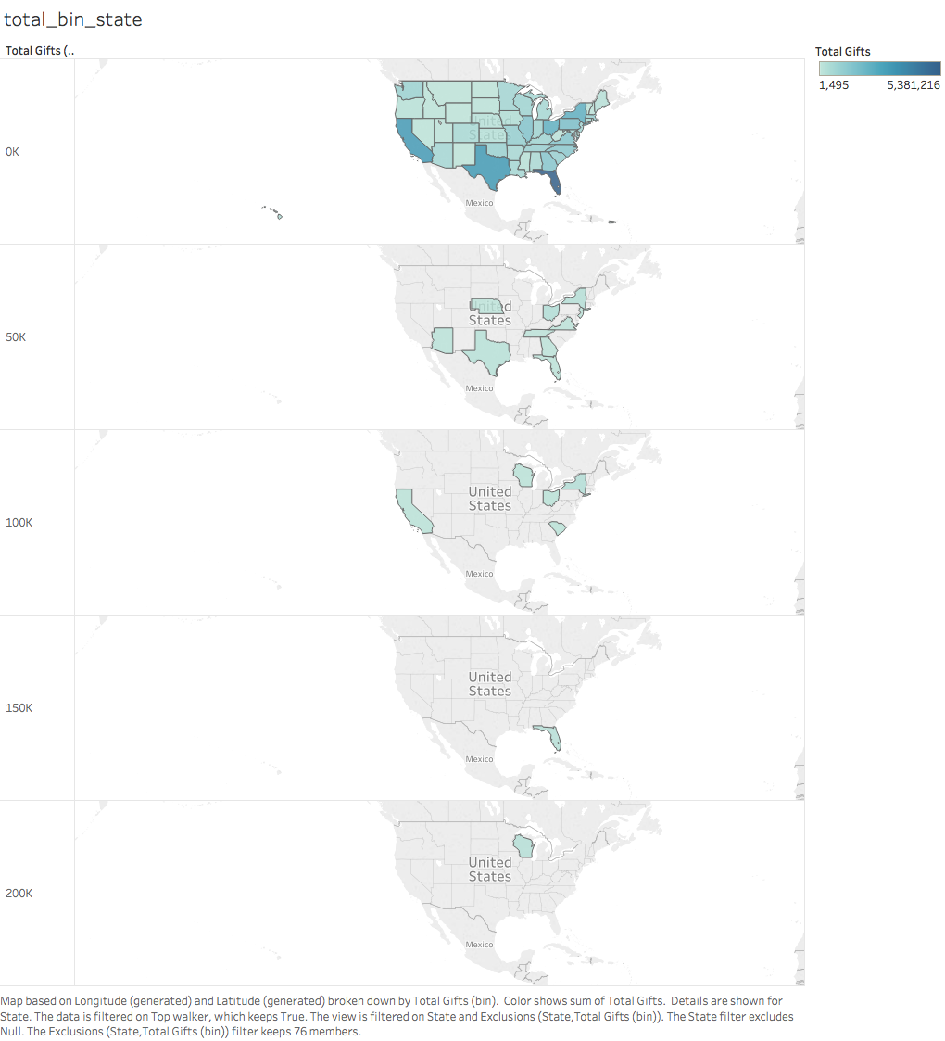

Slide 6
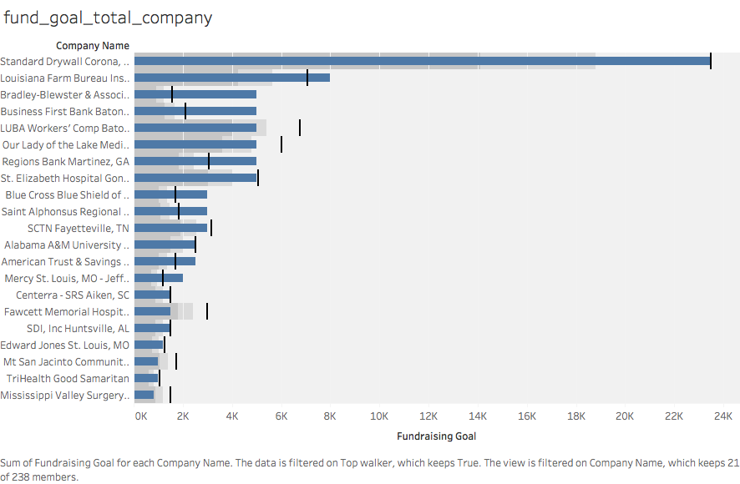
Fund raising goal-total gifts-top=true

Slide 7
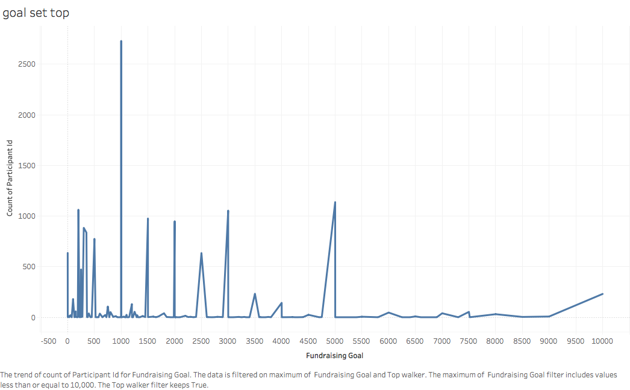
Distribution of fundraising goals for top walker

Slide 8
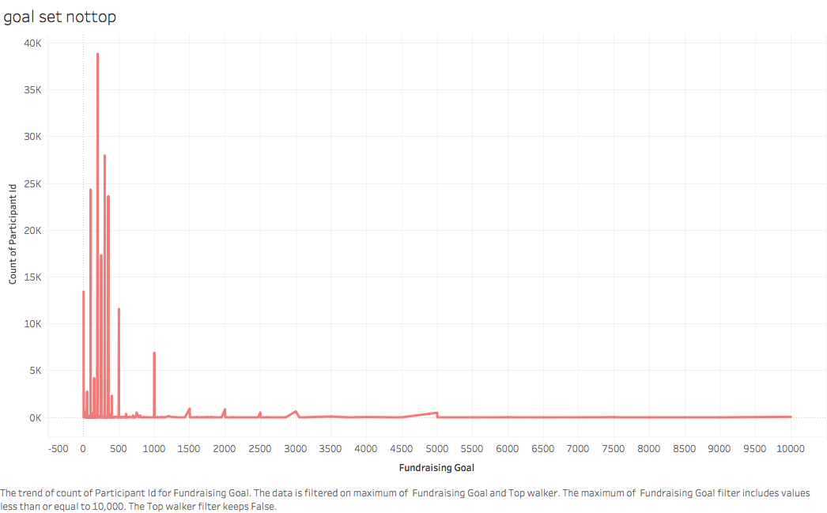
Distribution of fundraising goals for non- top walker

Slide 9
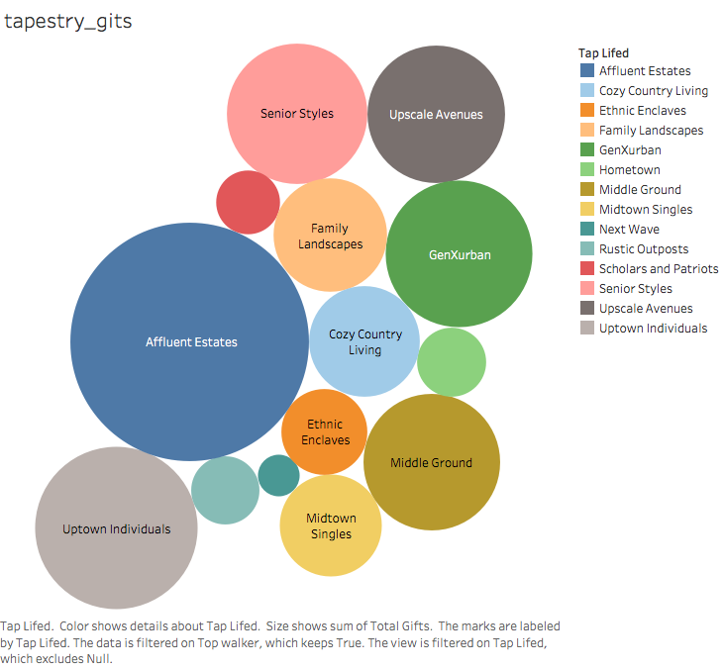
Tapestry description for top walkers by total gifts

Slide 10
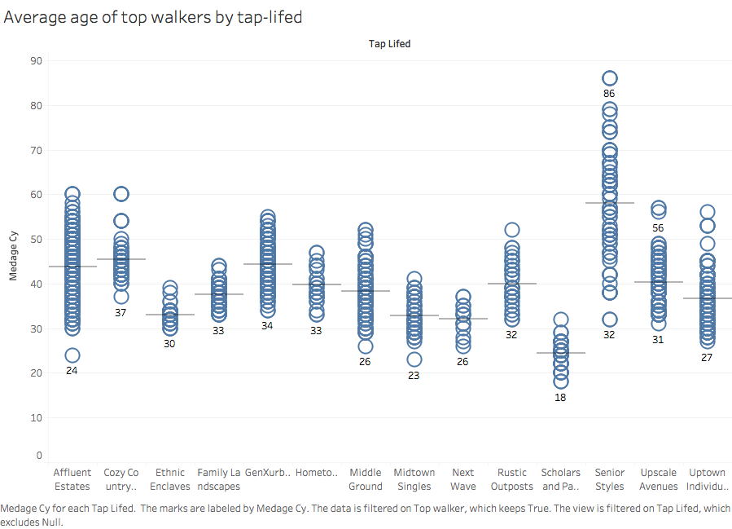

Slide 11
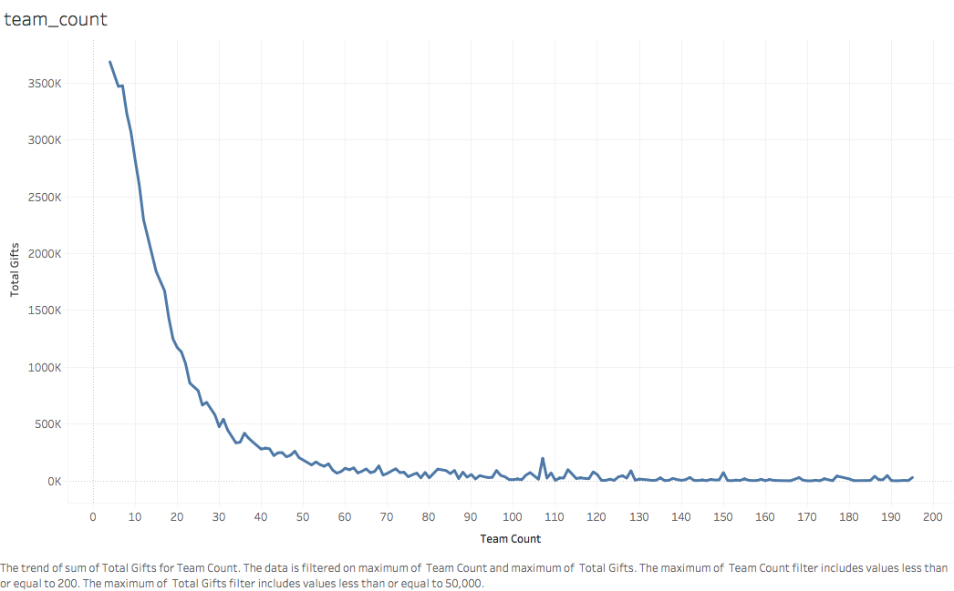

Slide 12
Top Walker Prediction Model
Workflow for the Predictive Model
Data
Data Cleaning
Data Exploration
Data Segregation
Train Data
Test Data
Data Modeling
Logistic Regression
SVM
Random Forest
XgBoost

Slide 13
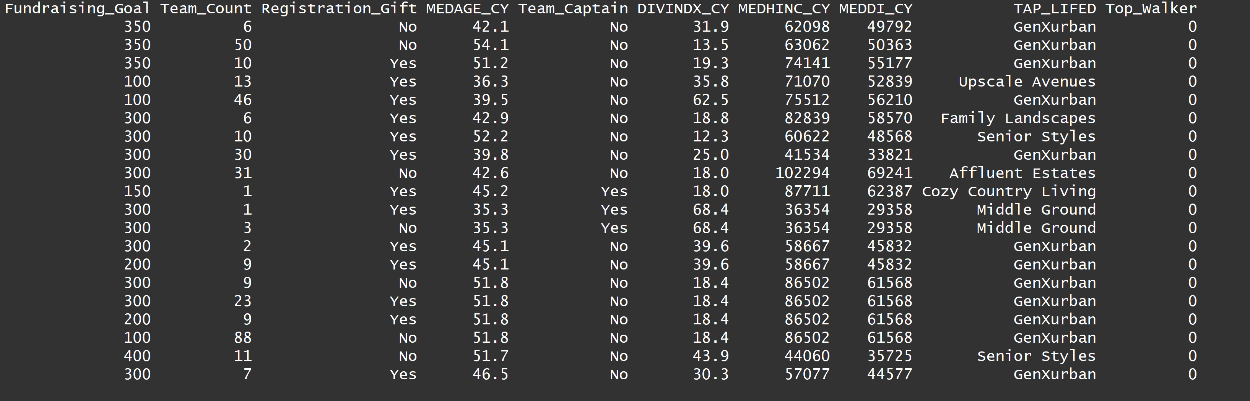
Top Walker Prediction Model
Variables used in the model are:

Slide 14
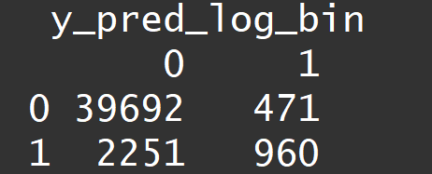
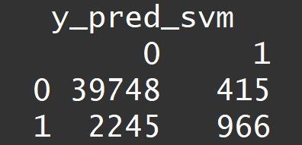
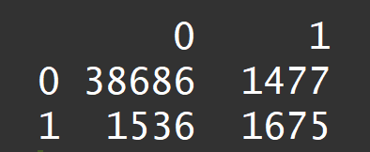
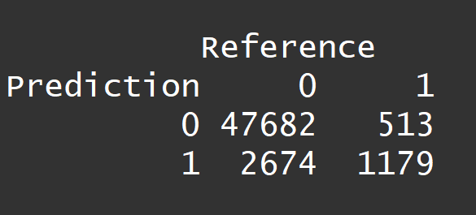
Classification Models
Logistic Regression
SVM
Random Forest
XgBoost
Confusion Matrix
Confusion Matrix
Confusion Matrix
Confusion Matrix
Accuracy: 0.9372
Recall: 0.2989
Precision: 0.67085
F measure: 0.4136
Accuracy: 0.9386
Recall: 0.3
Precision: 0.699
F measure: 0.42
Accuracy: 0.93
Recall: 0.5216
Precision: 0.5314
F measure: 0.5264
Accuracy: 0.9388
Recall: 0.696
Precision: 0.946
F measure:0.8019

Slide 15
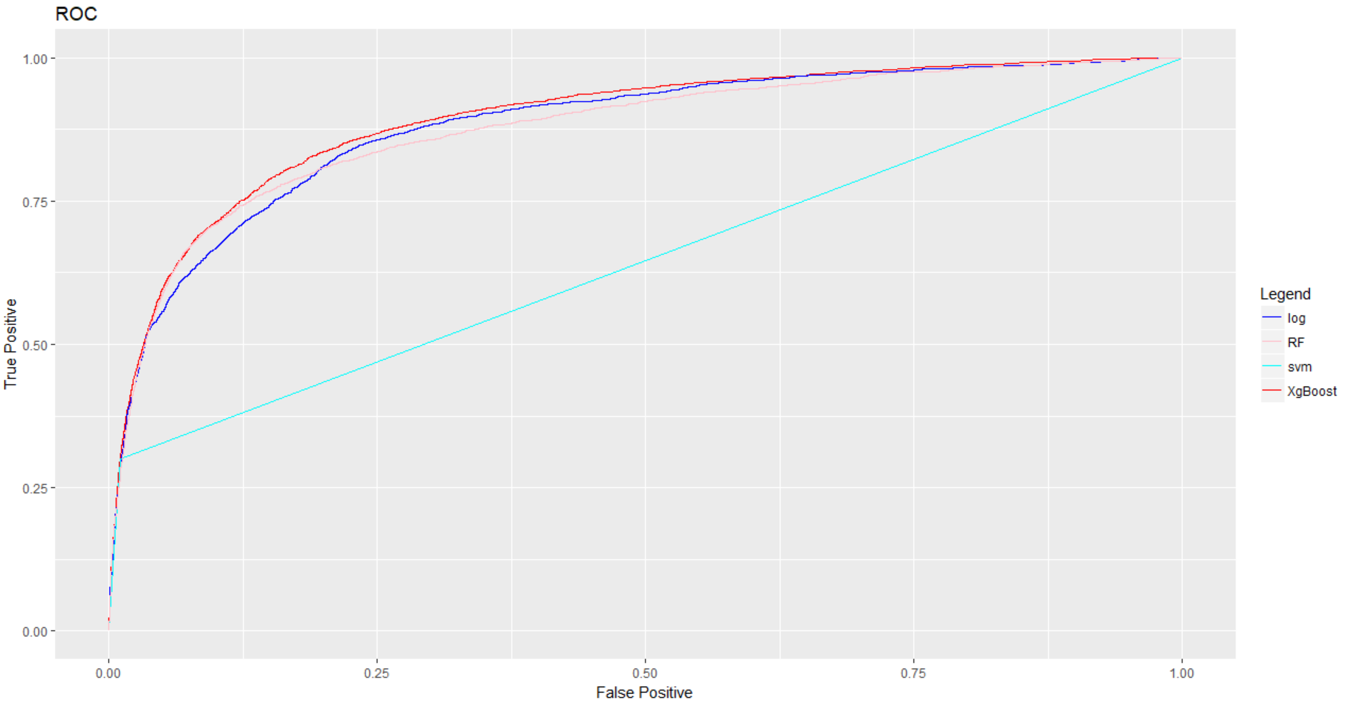
Model Comparison: ROC Chart
 | AUC
Logistic Regression | 0.881
SVM | 0.645
Random Forest | 0.876
Xgboost | 0.893

Slide 16
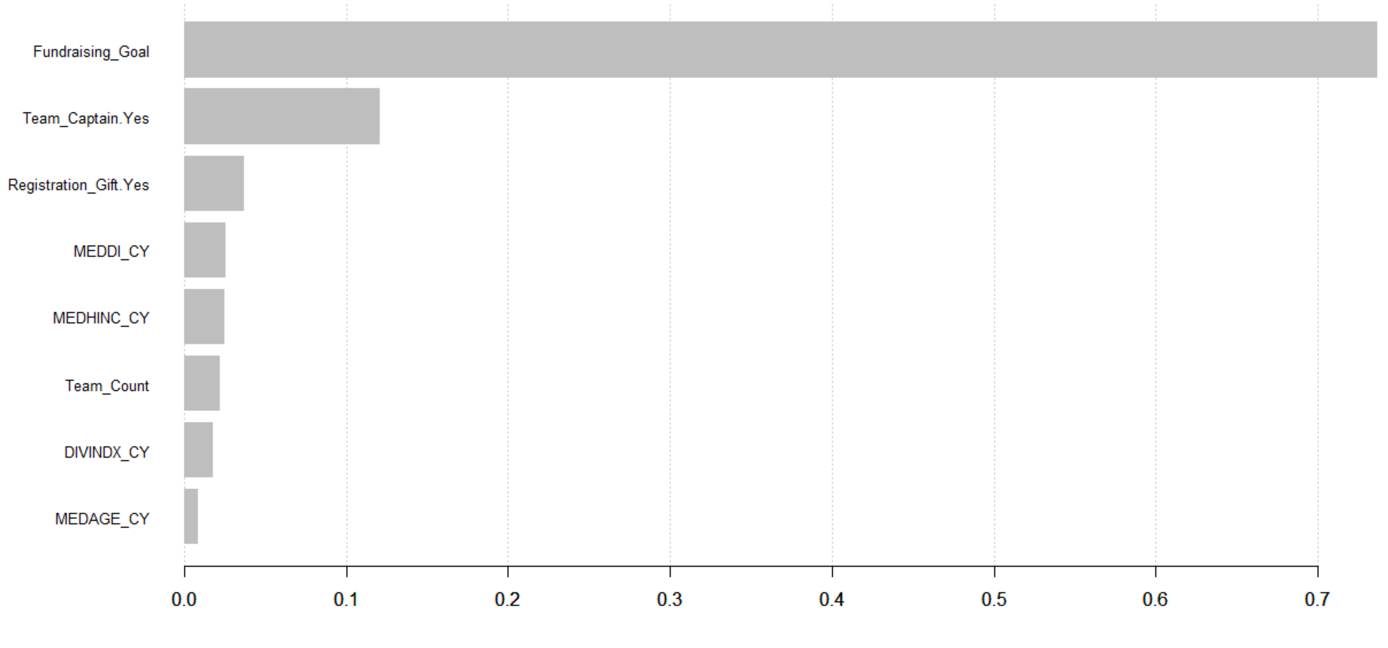
Feature Importance

Slide 17
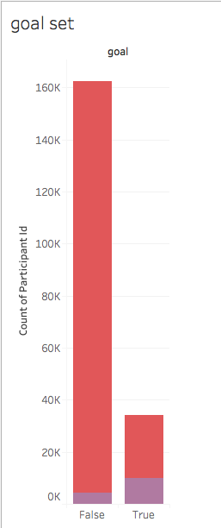
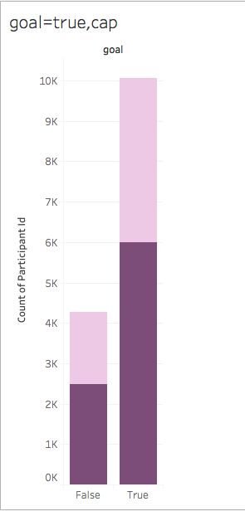
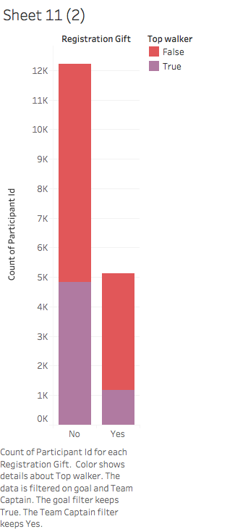
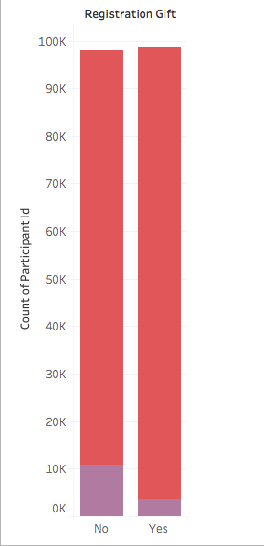
Understanding who a top walker is
Goal set >400 Top walker
Top walkers with goal>400 –team captains

Slide 18
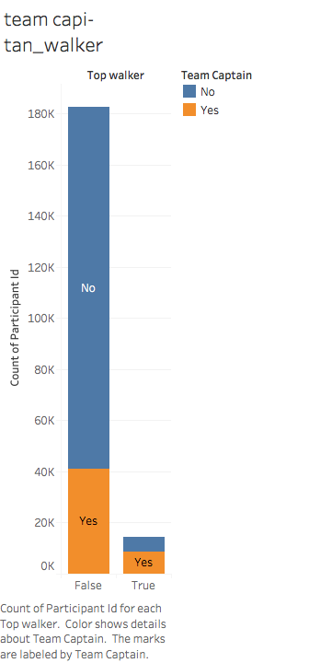
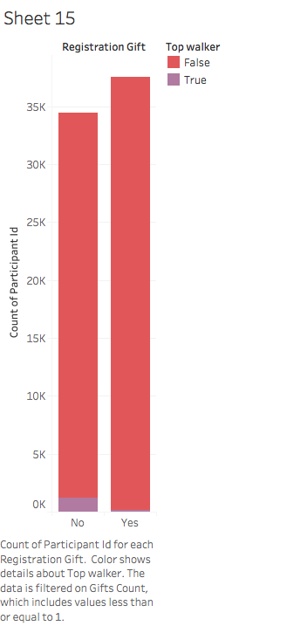

Slide 19
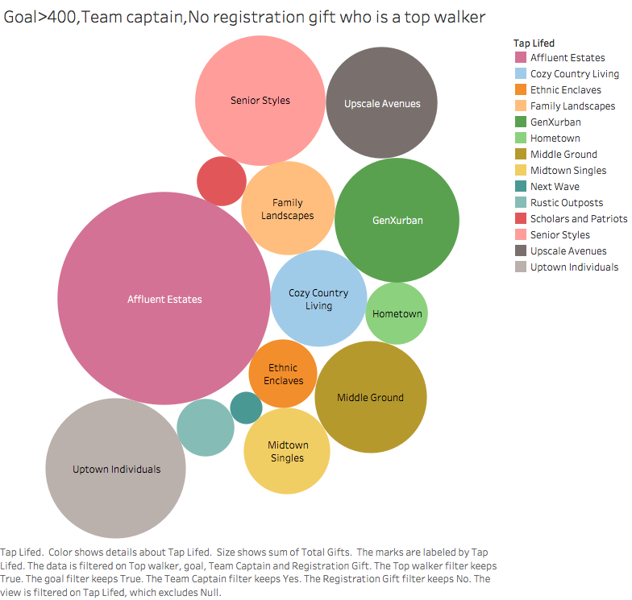

Slide 20
Fundraising goal (Goal>400)
Team captain (Yes/No)
Registration Gift (Yes/No)
Tapestry (Affluent estates with Average age 45)

Slide 21
Recommendations
Fundraising Goal Setting
Identify Loyal Top Walkers

Slide 22
Market Analysis

Slide 23
Need for Market Analysis?
Which events are driving the AHA revenue?
Which other event could bring more revenue ?
Determine untouched markets to increase the revenue
Recommended events based on neighborhood events

Slide 24
Main factors driving the AHA revenue
Total Revenues from the events in
2013 - $172 million
2014 - $189 million
2015 - $199 million
2016 - $215 million
Recommendation:-
Preforming this events more will increase the revenue for sure in all states. Frequency of these events should increase.

Slide 25
What are other potential events?
Corporate Donations –
2013 - $366,665
2014 - $344,142
2015 - $125,344
2016 - $144,548
Considering the Corporate Donations as one of the potential event and focusing on it.

Slide 26
Corporate Donations
Top 5 Markets
Example: Untouched Markets in Corporate Donations
Indianapolis
Detroit Metropolitan Area
Norfolk City in Virginia
High Point City in North Carolina
Nampa City in Idaho
Lancaster City in Texas If we could do events in this markets as well we will have a significant amount of donations.

Slide 27
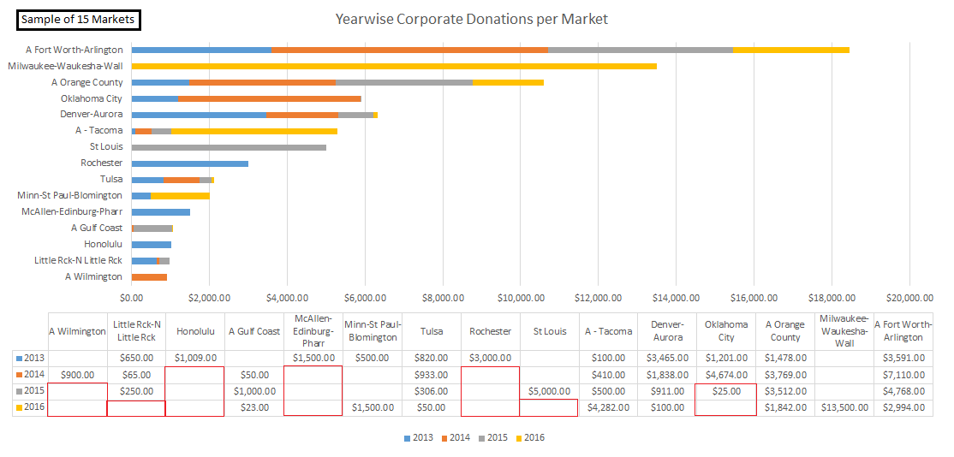

Slide 28
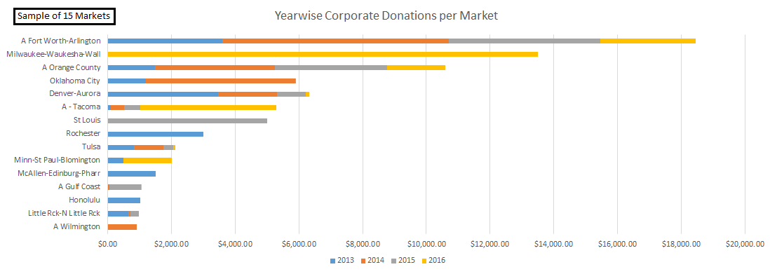
Potential markets from which AHA could get more revenue
- Oklahoma City, St Louis, Rochester city, Edinburg & Pharr city etc

Slide 29
Further analysis is done by dividing top markets into two groups
Top 50 Markets
Bottom 50 Markets
Findings –
How to improve revenues in some areas which are producing low revenues
How to maintain revenues achieved in previous years

Slide 30
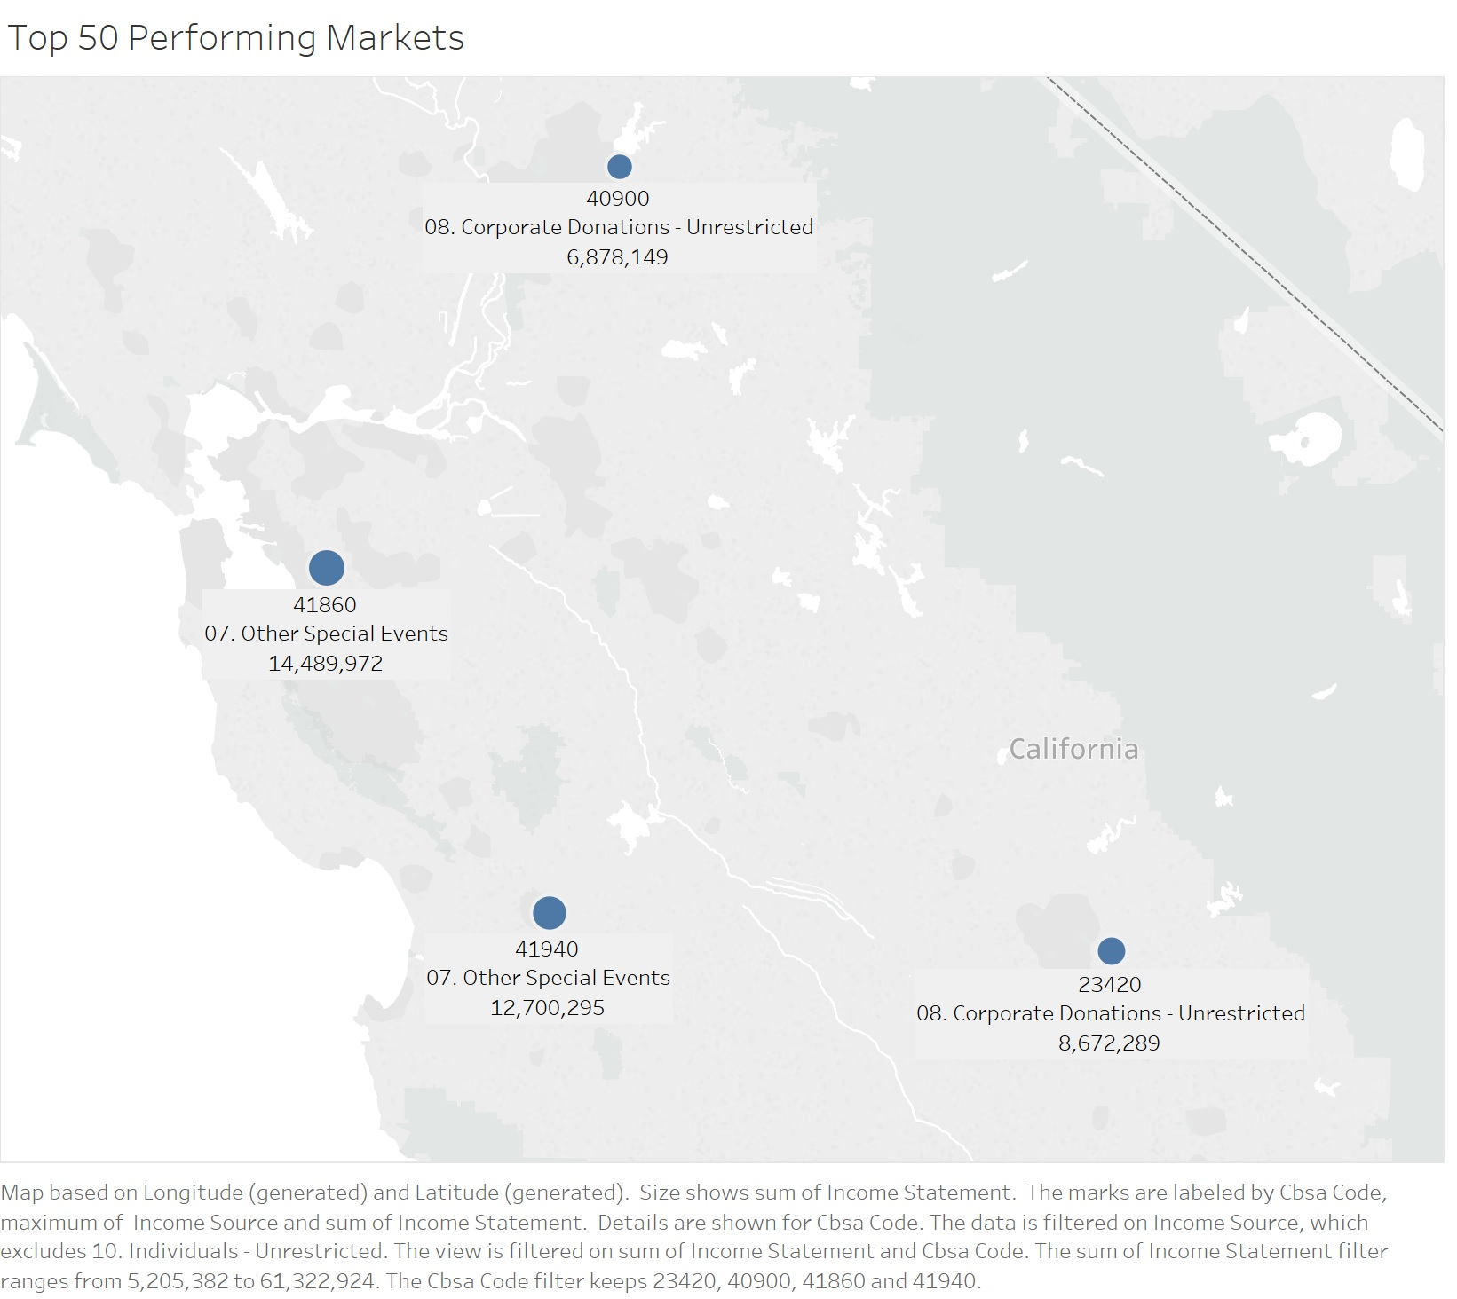
Top 50 Markets - California
You can observe that CBSA areas 41860 and 41940 are achieving nearly double income as compared to areas 40900 and 23420.
Observe the events

Slide 31
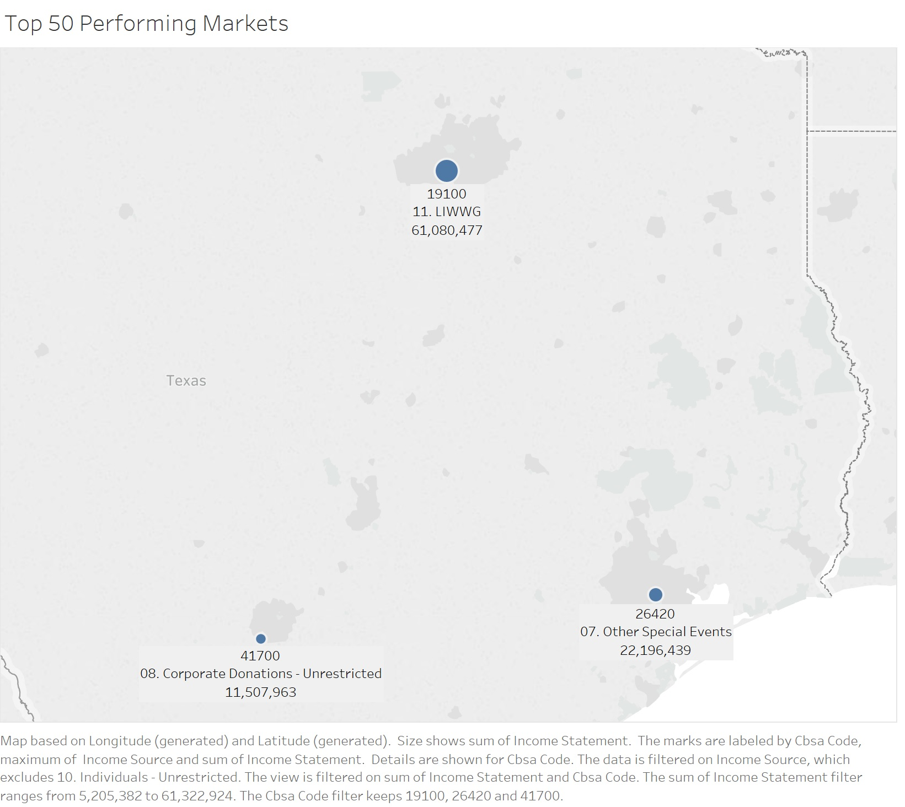
Top 50 Markets - Texas
CBSA area 19100 is giving more income than areas 41700 and 26420 combined.
Observe the events

Slide 32
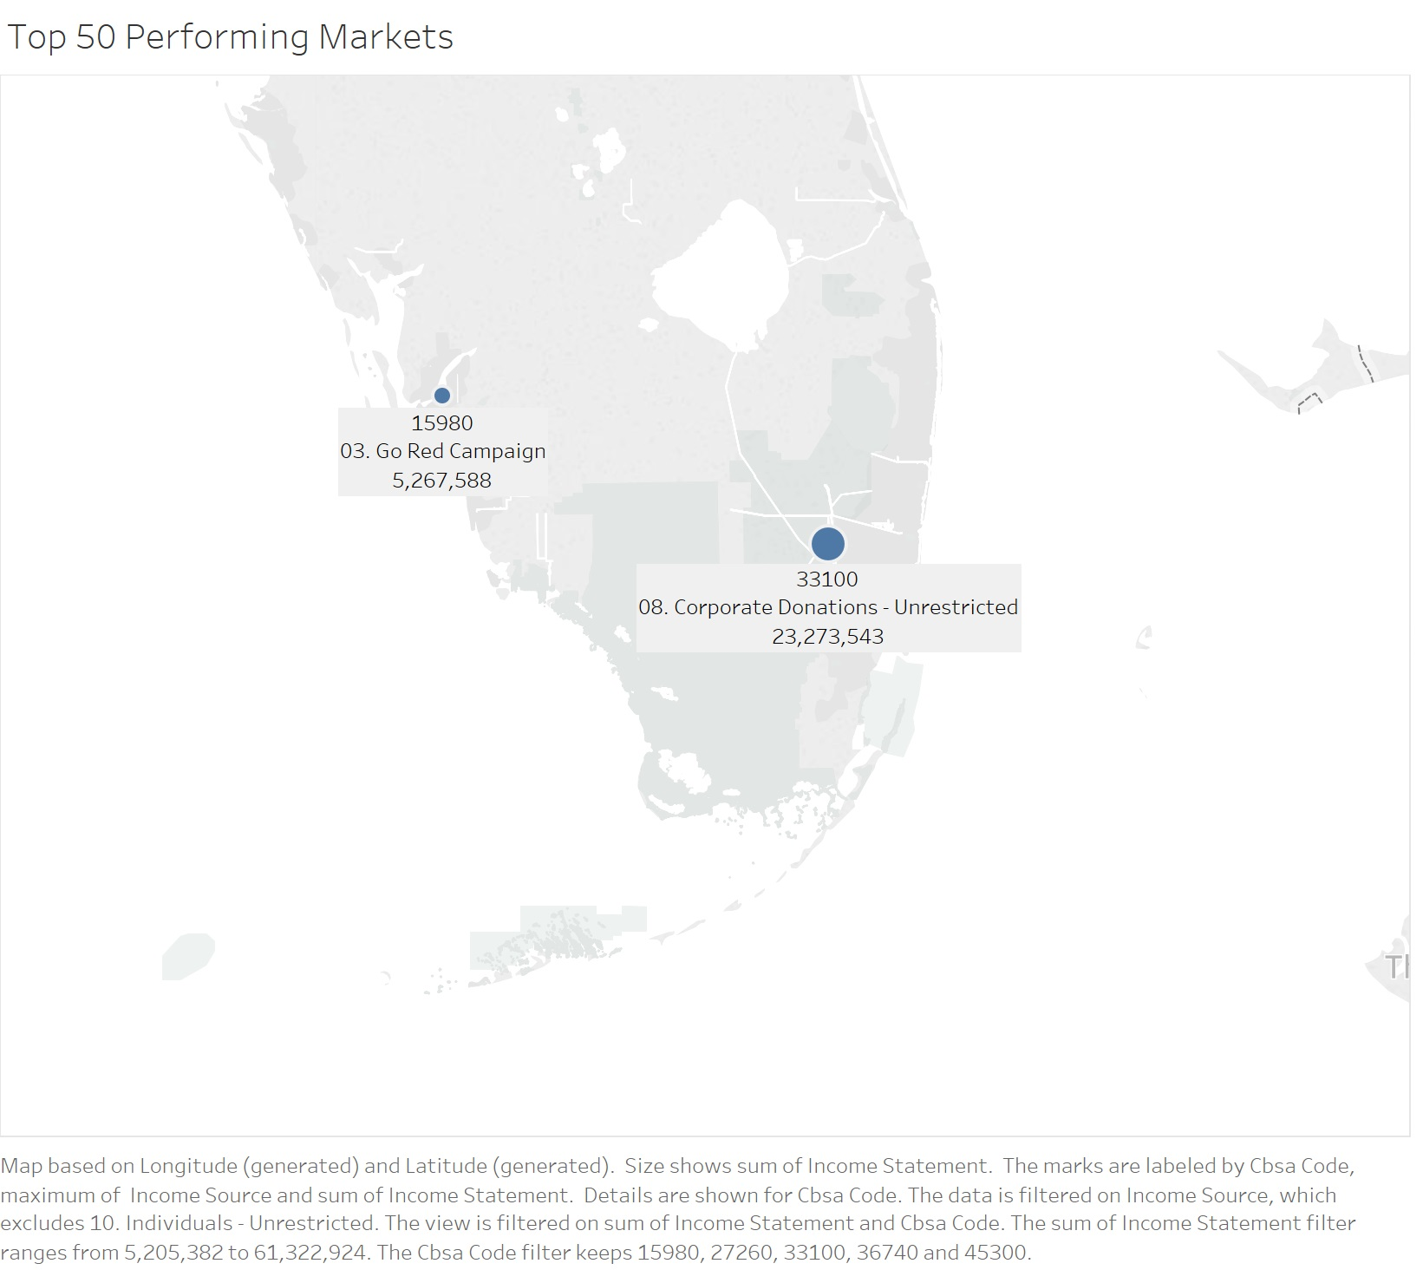
Top 50 Markets - Florida
Comparison CBSA area 33100 vs 15980
Observe the events
What we suggest is running same events which are successful in neighboring areas

Slide 33
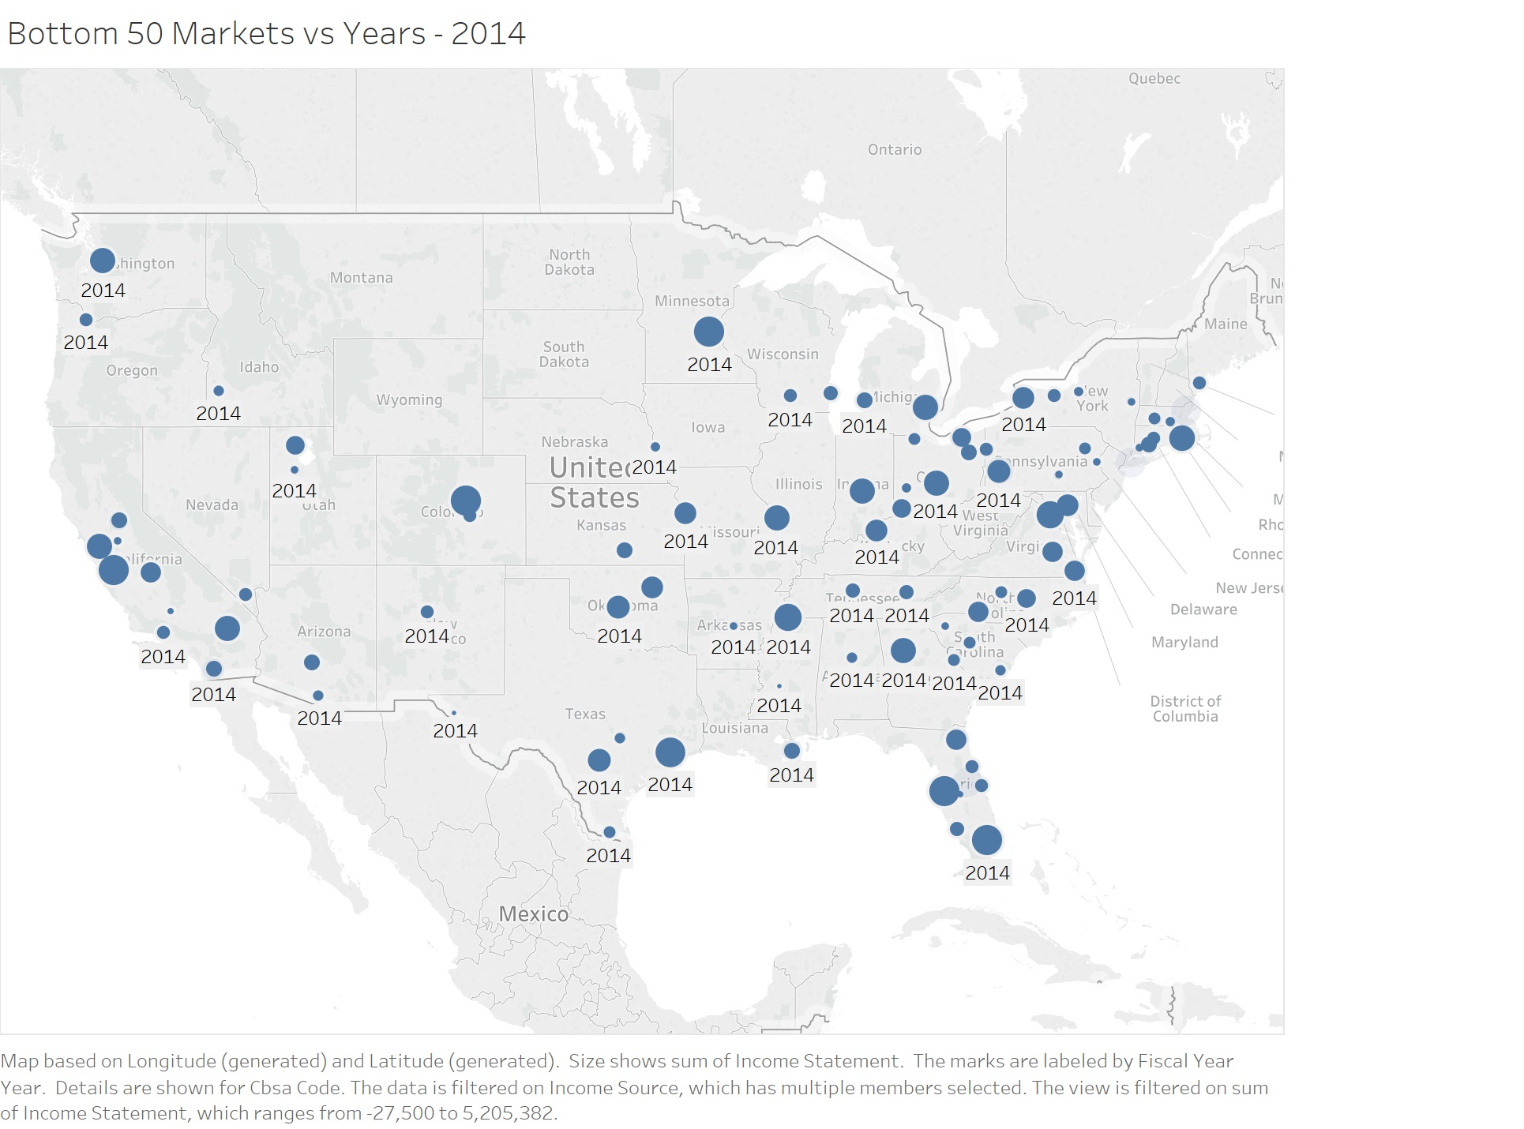
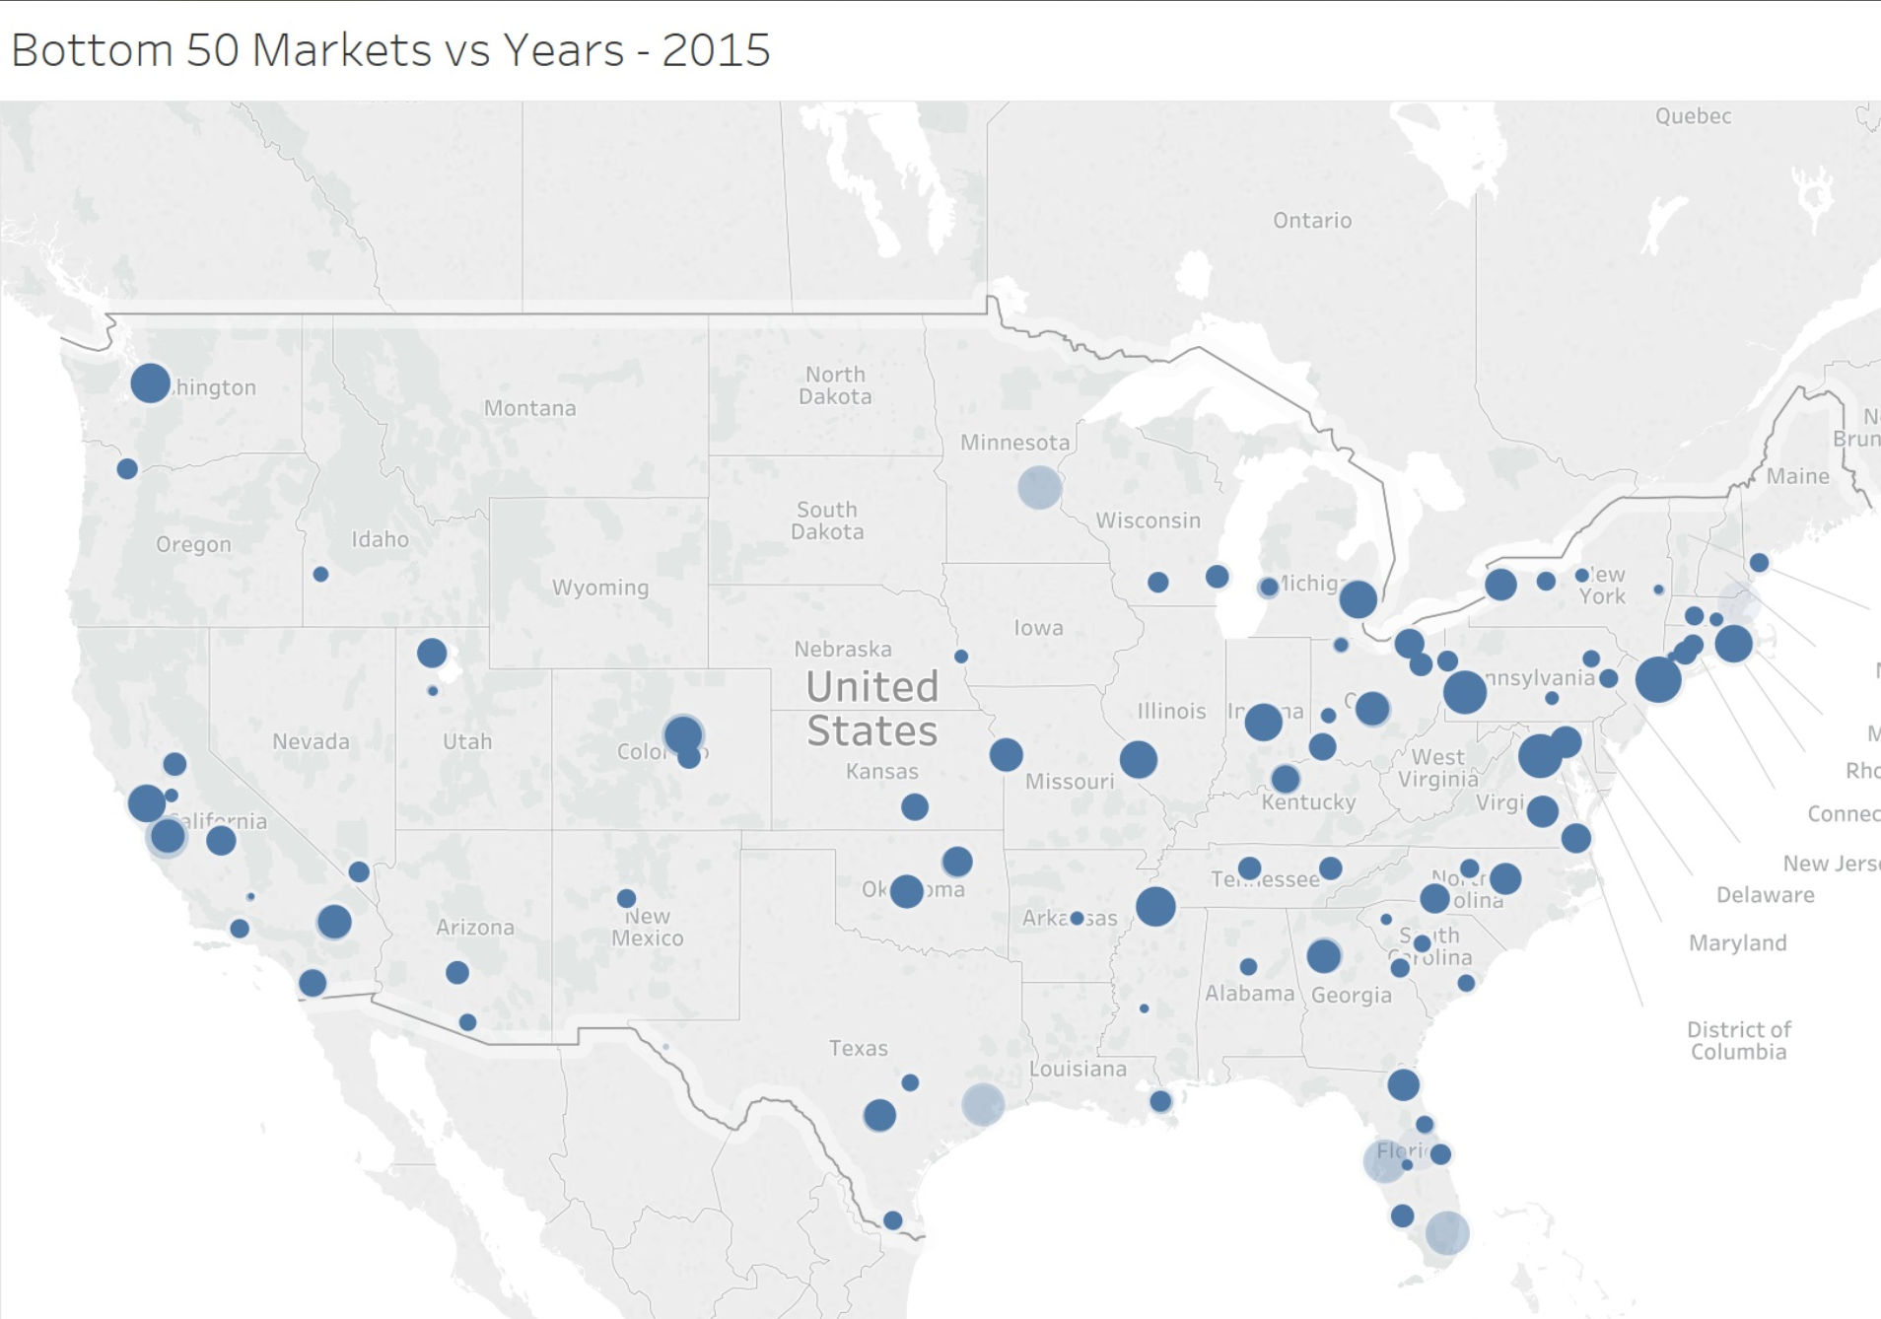
Comparison over years 2014 vs 2015

Slide 34
Comparison over the years
Previous geographical analysis highlights gaps between the events
To generate revenue doing events in top performing areas is important factor
Tableau file for market analysis is attached with project document, further observations for improving and maintaining donations are visible in this file

Slide 35
Thank you

